Slide 1









GLOBAL ACADEMY OF TECHNOLOGY
An Autonomous Institute, Affiliated to VTU Belagavi, Approved by AICTE, Accredited by NAAC with "A" Grade, Ideal Homes Township, Rajarajeshwari Nagar, Bengaluru-560098
# BEYOND INNOVATION
Project Title: AI-Powered Exercise Tracking and Health Management System.
Team Name: ROOKIES
Team Number: HAL47
Team Members: Nishanth H R, Nandeesh C M, Roopa Bagalkoti
College Name: R V College of Engineering Bengaluru

Slide 2
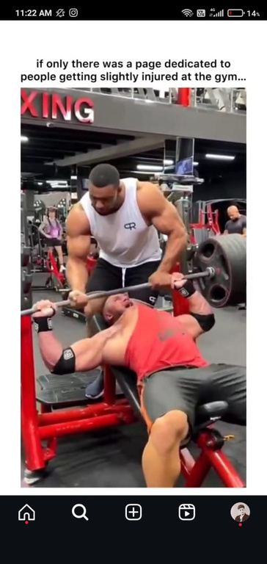
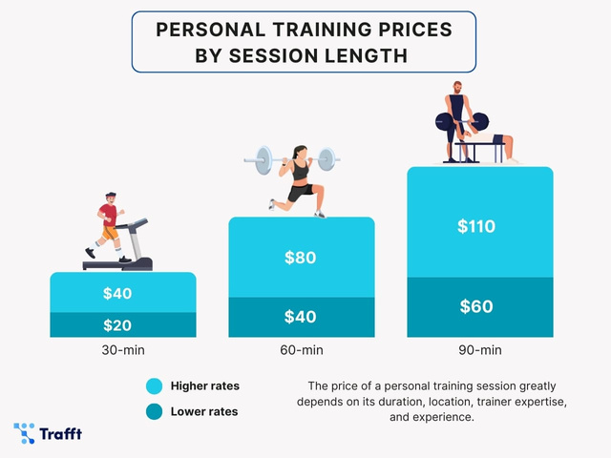
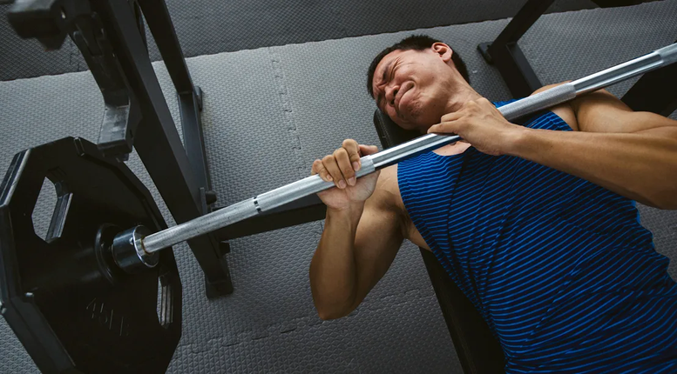

PROBLEM STATEMENT
Many fitness systems lack real-time feedback, accurate tracking, and automation, leading to ineffective workouts, injuries and limited accessibility. High costs, manual nutrition analysis, and external factors affect reliability, emphasizing the need for an AI-driven solution integrating exercise tracking, posture correction, and food analysis.

Slide 3


SCOPE
Comprehensive Fitness Tracking: Integrates AI-powered real-time exercise monitoring, posture correction, and food composition analysis for a holistic fitness experience.
Enhanced Workout Efficiency & Safety: Uses MediaPipe Pose for posture estimation and YOLOv8 for food recognition, reducing injury risks and improving exercise accuracy.
Automation & Personalization: Eliminates manual data entry with automatic repetition counting, BMI calculation, and customized workout & diet plans based on user health goals.
Accessibility & Cost-Effectiveness: Provides an AI-driven fitness trainer without requiring expensive sensors or specialized hardware, making it more affordable and widely accessible.
Addressing Health & Lifestyle Challenges: Helps users maintain proper form, track nutrition, and stay consistent with fitness goals, addressing real-world issues like sedentary lifestyles and poor dietary habits.

Slide 4
SOLUTION REVIEW
Our innovative solution is an AI-powered fitness system that provides real-time exercise tracking, posture correction, and food composition analysis using computer vision and machine learning. It automates repetition counting, form correction, and nutritional tracking to enhance workout efficiency, reduce injury risks, and improve dietary awareness.

Slide 5
TECHNICAL APPROACH
Pose Estimation: Uses MediaPipe Pose to analyze body posture and ensure correct exercise form.
Object Detection for Food Recognition: Implements YOLO to identify food items and analyze their nutritional composition.
Automation & Personalization: Integrates repetition counting, and customized workout/diet plans based on user health data.
Platform Implementation: Developed using Python, OpenCV, TensorFlow, and Flask/React for a user-friendly interface.

Slide 6
IMPACT AND BENEFITS
Target Group: Fitness enthusiasts, home workout users, and individuals seeking personalized health guidance.
Social Benefits: Encourages healthier lifestyles, reduces injury risks, and promotes better dietary habits.
Economic Benefits: Eliminates the need for expensive wearable sensors, making fitness tracking cost-effective and accessible.
Environmental Benefits: Digital tracking reduces paper-based logs and promotes sustainable fitness practices.

Slide 7

CONCLUSION
This AI-powered fitness system addresses the limitations of manual and sensor-based tracking by providing an automated, real-time, and cost-effective solution. With potential for scaling, future improvements can include multi-user support, AR-based workout assistance, and integration with smart wearables, making fitness training more accessible, engaging, and efficient for a global audience.

Slide 8
Thank You

